Slide 1
CHAT APPLICATION WITHOUT API
GUIDED BY, SUBMITTED BY,
Ms.S.VANITHAMANI HOD/MCA NATRAYAN N R (16MCA3321)

Slide 2
ABSTRACT
It is a web application. The purpose of the chat application is to allow users be able to the chat with each other, who are all register in this application.
The users will be able to chat with each other, most likely only from user to user, no group chatting will be developed.
This Application allow its users to chat with their friend circles.
This project provides a feature to send files, images and etc.
And also this project provide change password option is available.

Slide 3
EXISTING SYSTEM
Under the existing Chat System project, two different login pages is used: one for admin and other for its users, which is a time consuming process and fetching data from database also takes time.
No session id has been set from the server side in the existing system, by which system can be hacked and know the programming details of the server side.
Existing system does not provide the feature of sending documents from one person to other person because they haven’t uses the concept of file up loader

Slide 4
DISADVANTAGES
Not allow its users to maintain its personal information.
Set its visibility features to other users who are available in their chat circles.

Slide 5
PROPOSED SYSTEM
Chat in Local System connection so it is cheap.
Better Communication.
Secure and safe system.
Flexible system you can edit its source code to make it more attractive or useful.
We can share files also through this system.

Slide 6
ADVANTAGES
Chat screen will open which will display the user name.
It will also maintain the chatting history data and conversation data between user to user.
When the user will click on Logout button, it will destroy their session which has been set by the server side and making all their property to null, by which their account will not be hacked.

Slide 7
SYSTEM SPECIFICATION
HARDWARE REQUIREMENTS
Processor : INTEL INSIDE PENTIUM
RAM : 2GB
Hard Disk : 500GB
Monitor : Acer Gateway
Keyboard : 108 Enhanced
Mouse : Logitech 3 Buttons

Slide 8
SOFTWARE REQUIREMENTS
Operating System : Windows 7 Ultimate
Front End : HTML, CSS, JAVASCRIPT, AJAX
Back End : PHP
Database : MySQL
Server : XAMPP v3.2.2

Slide 9
MODULES
User register module
Login module
Chat module
Chat list module
Chat box module
Settings
Change password
Logout

Slide 10
MODULE DESCRIPTION
USER REGISTER MODULE
User must be able to register for the application through a valid username and password.
LOGIN MODULE
Who are all the registered users only login the chat application.
CHAT MODULE
In this module divide the two parts.
Chat list
In this chat list module only registered users shown on the left side on the chat application.
The user choose to name list a user chat with each other.

Slide 11
MODULE DESCRIPTION
Chat box
In this chat box module, submit message will be display in right side.
And also, chat user message will be display is left side on the chat box.
SETTINGS
In this settings module, have a two modules.
Change password
The user want to change our password
Logout
When the user will click on Logout option, it will destroy their session which has been set by the server side and making all their property to null, by which their account will not be hacked.

Slide 12
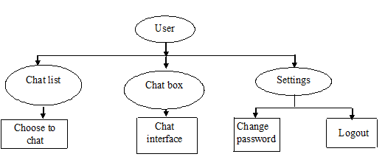
DATA FLOW DIAGRAM

Slide 13
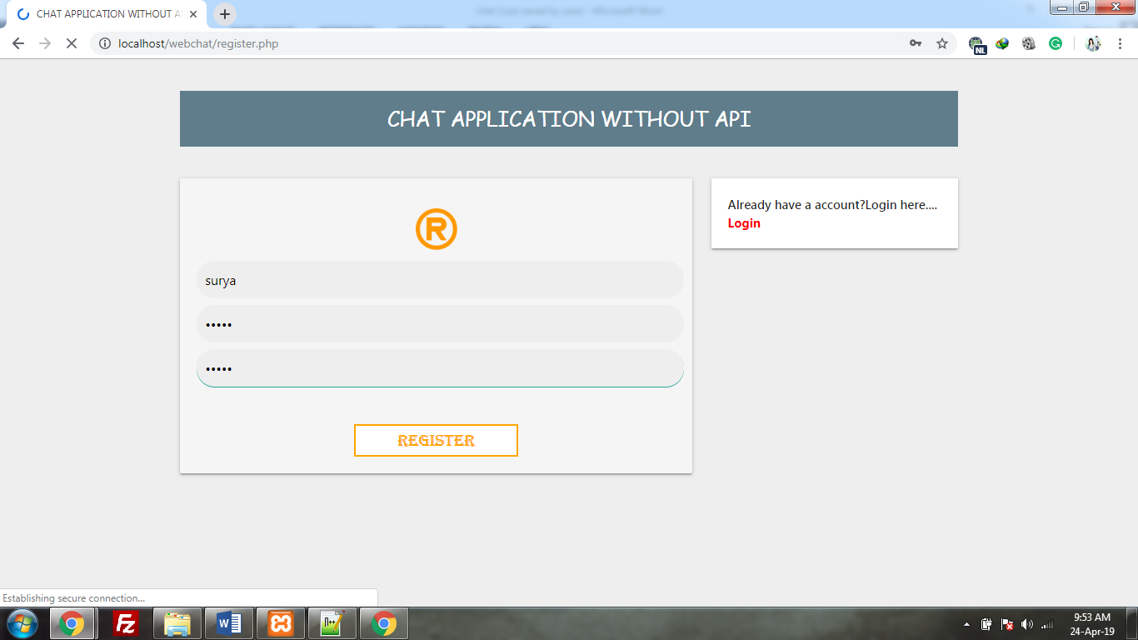
SCREENSHOTS
User Registration Page

Slide 14
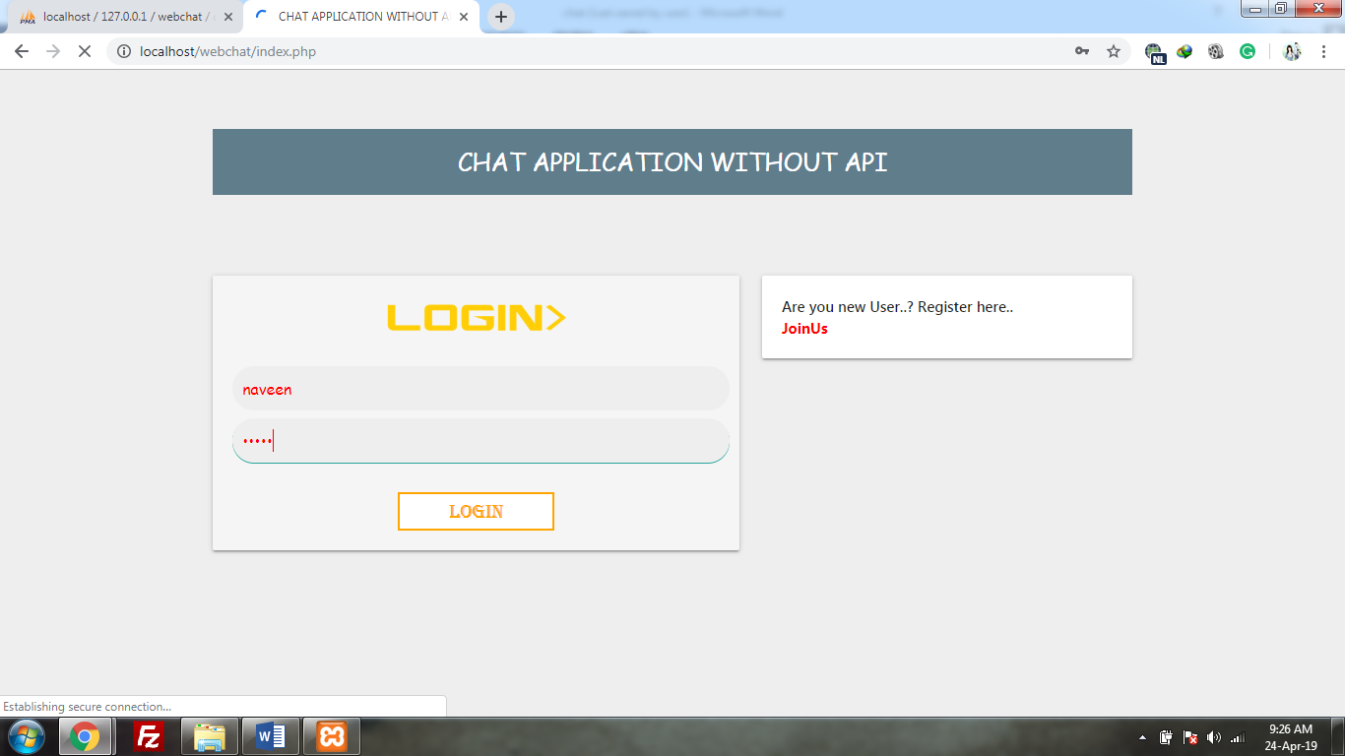

Slide 15
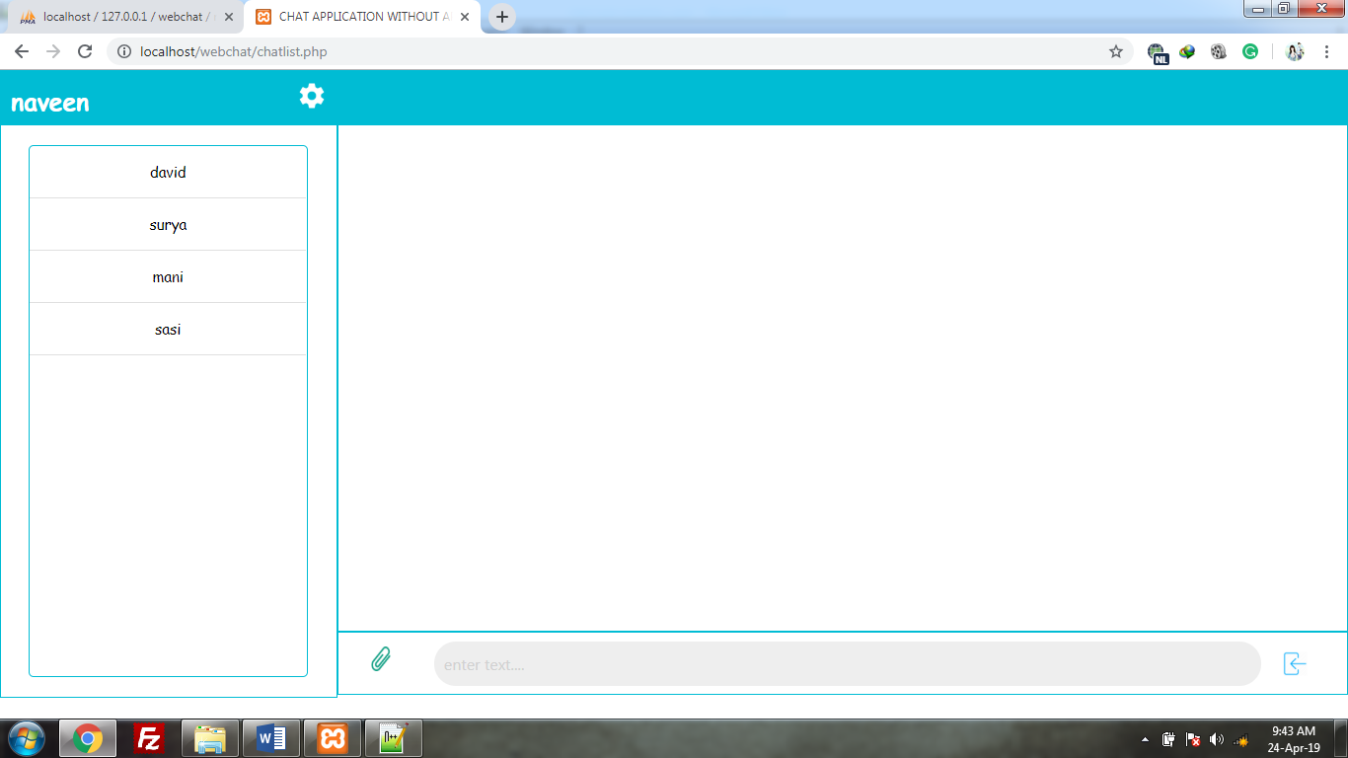

Slide 16
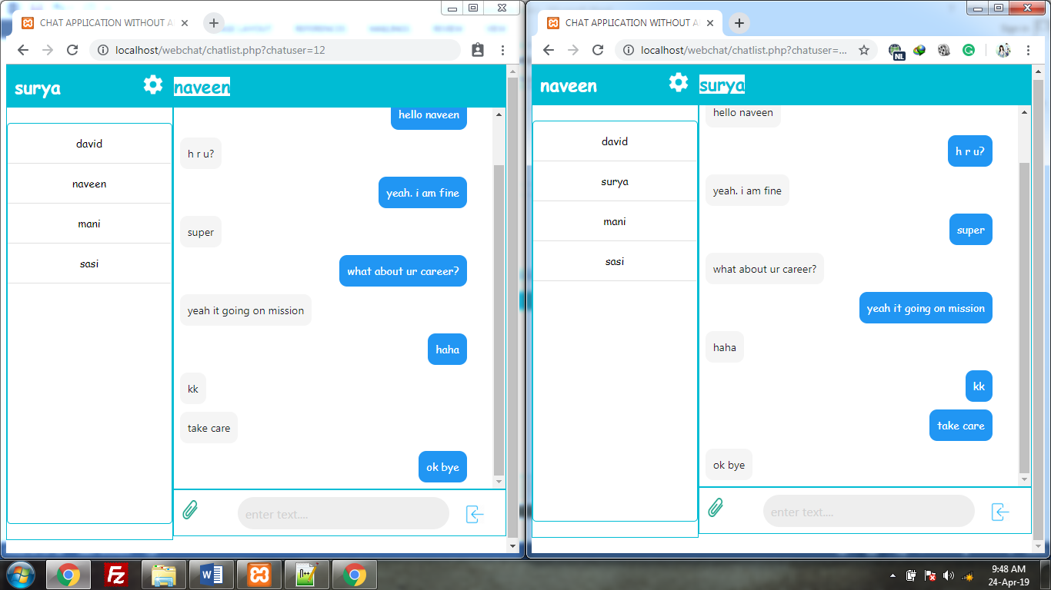

Slide 17
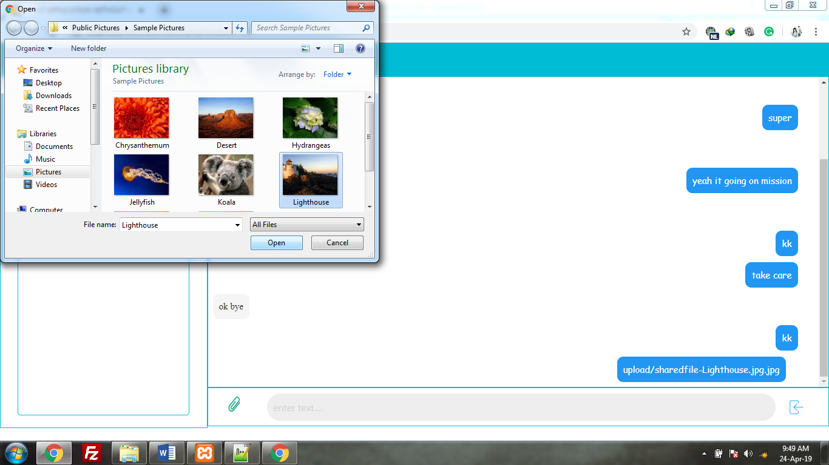

Slide 18
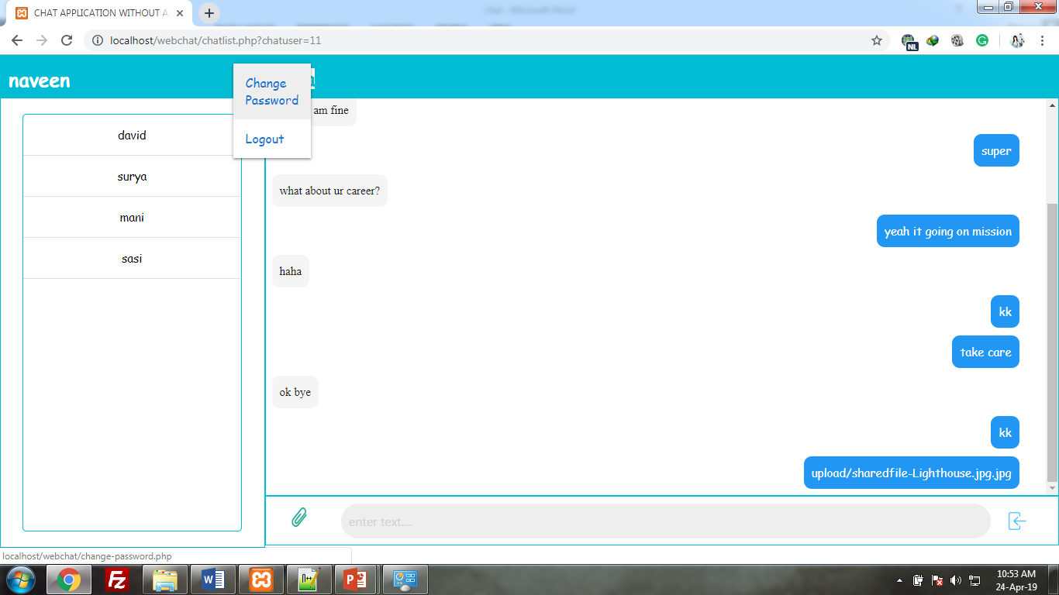

Slide 19
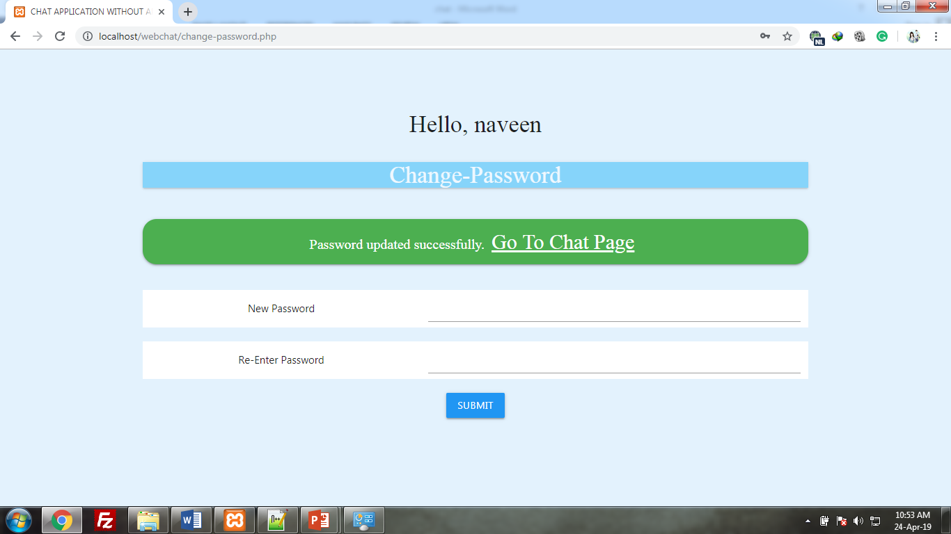

Slide 20
CONCLUSION
The purpose of the web chat application is to allow users be able to the chat with each other, who are all register in this application. The users will be able to chat with each other, most likely only from user to user, no group chatting will be developed. This Application allow its users to chat with their friend circles. This project provides a feature to send files, images and etc. And also this project provide change password option is available.

Slide 21
FUTURE ENHANCEMENTS
In the future the app may include features like,
Group chat option will be update in future
Add the user profile image
Add the edit profile in the application

Slide 22
REFERENCES
https://code.tutsplus.com/tutorials/how-to-create-a-simple-web-based-chat-application--net-5931
https://www.script-tutorials.com/how-to-easily-make-a-php-chat-application/

